Slide 1

Group Members
Software Development
& Construction
Semester Project
Supervisor
Dr Zunnurain Hussain
Coordinator
Sir Umair Makhdoom
Muhammad Hamza BSSE23001
Muhammad Sarmad Ahmad BSSE23013
Hafiz Azfer Umar Sheikh BSSE23064

Slide 2

Scalable E-Commerce with Microservices on AWS
Online Boutique

Slide 3
The Monolithic Bottleneck in E-Commerce
Traditional e-commerce platforms, built on monolithic architectures, face critical failures during high-traffic events.
Inefficient Scaling & Cost
Scaling a monolith is "all-or-nothing," duplicating idle services and leading to massive resource wastage and prohibitive cloud costs.
Cascading System Failures
Lack of fault isolation means a minor bug can crash the entire checkout process, causing total service outages.
Deployment Stagnation
Minor updates require full system rebuilds, stifling innovation and slowing security patches.

Slide 4
Project Executive Summary
Challenge
Rigid, monolithic legacy systems lead to latency, outages, and degraded customer experience.
Solution
A decoupled microservices ecosystem using the "Online Boutique" application for high availability and fault tolerance.
AWS Strategy
Multi-tiered VPC across Availability Zones, ECS with Fargate, dual-load-balancer, DynamoDB, Elastic Cache, and robust security.

Slide 5
Key Outcomes & Value
Our microservices architecture delivers a robust, production-ready environment.
99.9%
Availability Target
Achieved through multi-AZ deployment.
Automated Scalability
Adjusts compute resources based on real-time demand.
Reduced Attack Surface
Application logic isolated from the public internet.

Slide 6
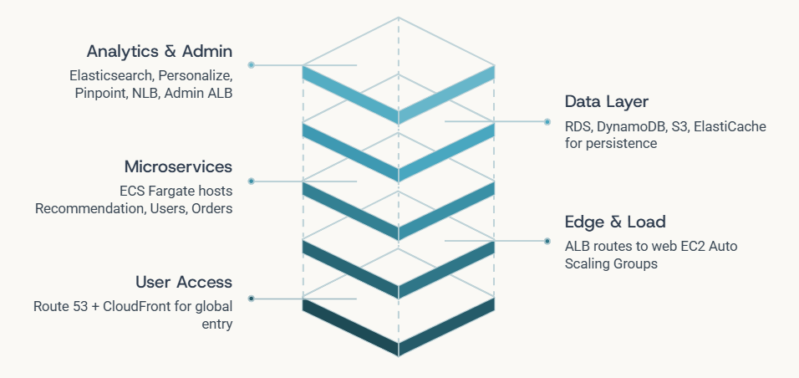
Architectural Overview
A multi-tier microservices architecture with discrete functional components communicating via REST APIs.

Slide 7
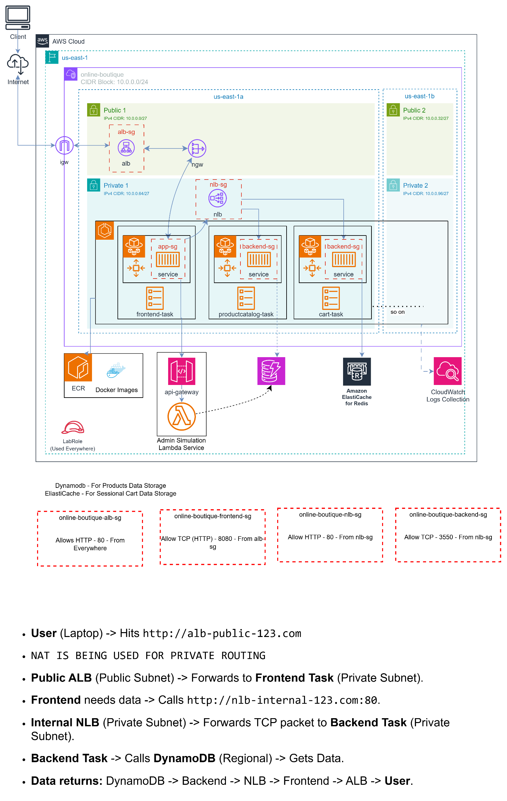
Diagrame1.1:Architecture

Slide 8
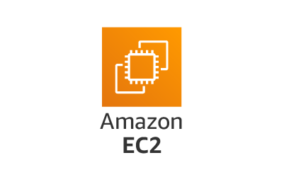





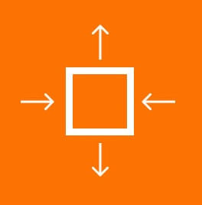

Core Component Analysis
Key AWS services utilized in our scalable e-commerce solution.
Compute
ECS Fargate for serverless container management, EC2 Auto Scaling for web servers.
Storage & Database
DynamoDB, S3, and Elastic Cache for diverse data persistence and caching needs.
Networking & Delivery
Route 53, CloudFront, and Elastic Load Balancing for efficient traffic management.
Analytics & ML
Personalize, Elasticsearch, and Pinpoint for intelligent recommendations and engagement.

Slide 9
Data Flow Description
A streamlined process from user access to backend operations and analytics.
DNS Resolution & CDN
Users access via Route 53; static assets served by CloudFront from S3.
Frontend & Microservices
Traffic to web servers (EC2 Auto Scaling), then to ECS Fargate microservices.
Data Persistence
Product/Analytics services use DynamoDB.
AI & Marketing
User behavior to AWS Personalize; triggers to AWS Pinpoint for engagement.

Slide 10
Implementation Report
IAM, Network, and Security Configuration
Objective: Create a secure, isolated network environment.
IAM Roles: Created ECS_Task_Execution_Role allowing Fargate to pull images from ECR and write logs to CloudWatch.
VPC Setup: Configured a VPC (10.0.0.0/16) with 2 Public Subnets (for ALBs) and 4 Private Subnets (for App/DB layers).
Security Groups:
ALB-SG: Allow Port 80/443 from 0.0.0.0/0.
App-SG: Allow traffic only from ALB-SG.
DB-SG: Allow traffic only from App-SG on port 3306 (MySQL).

Slide 11
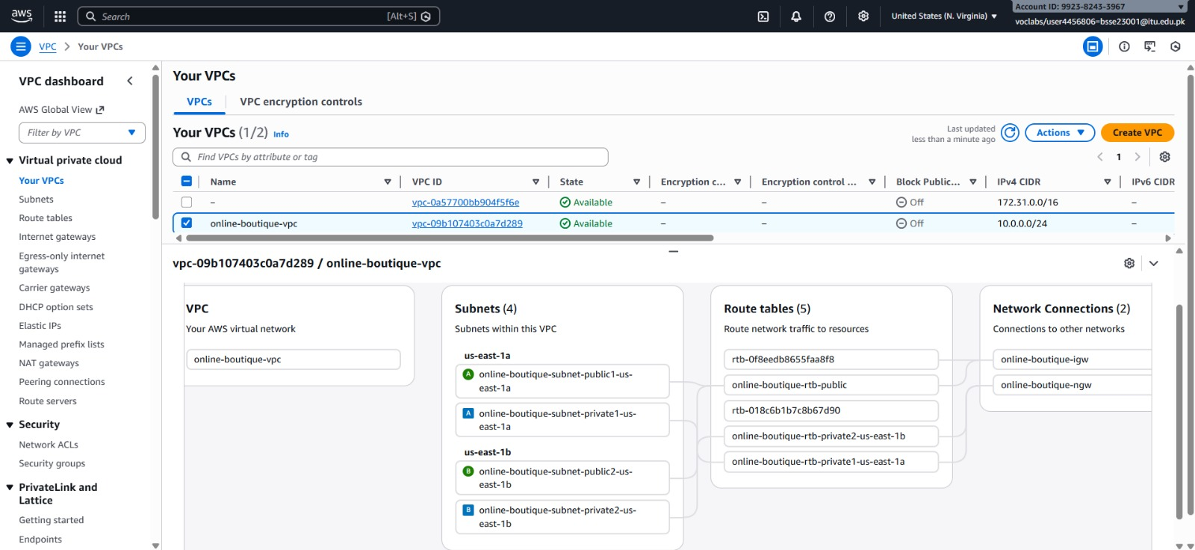
VPC

Slide 12
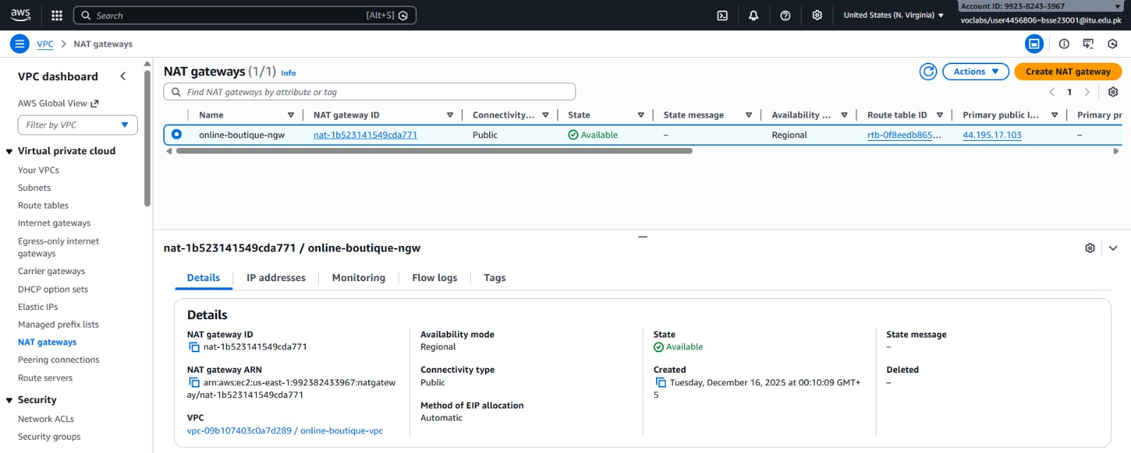
NAT Gateway

Slide 13
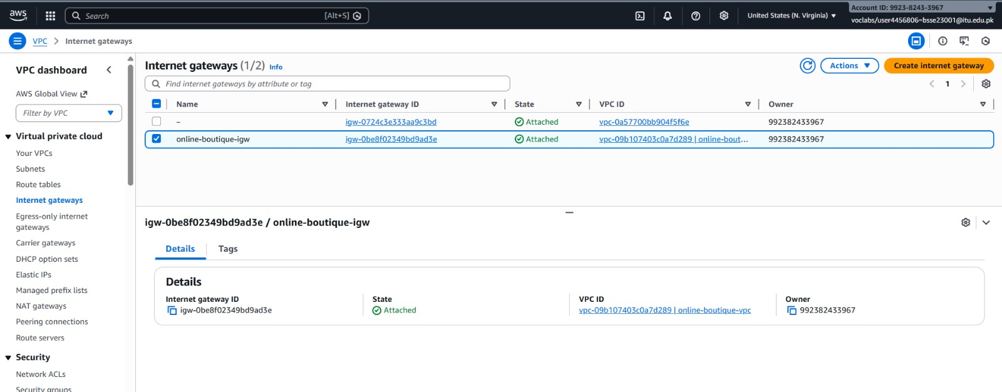
IGW

Slide 14
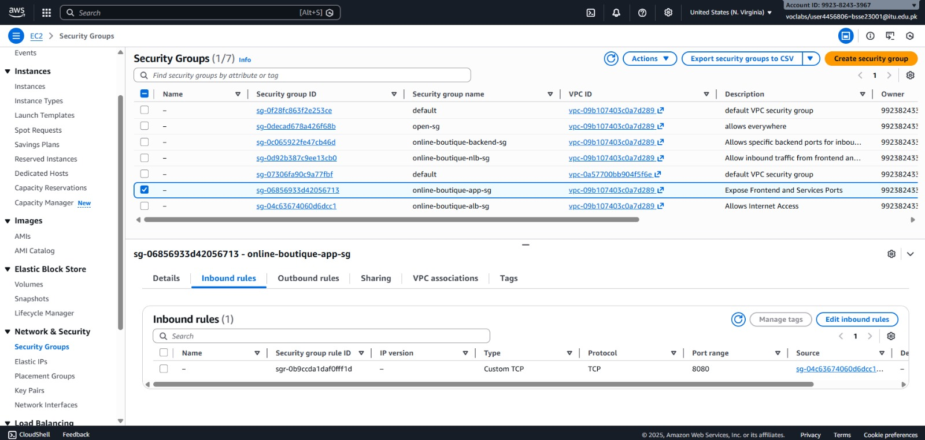
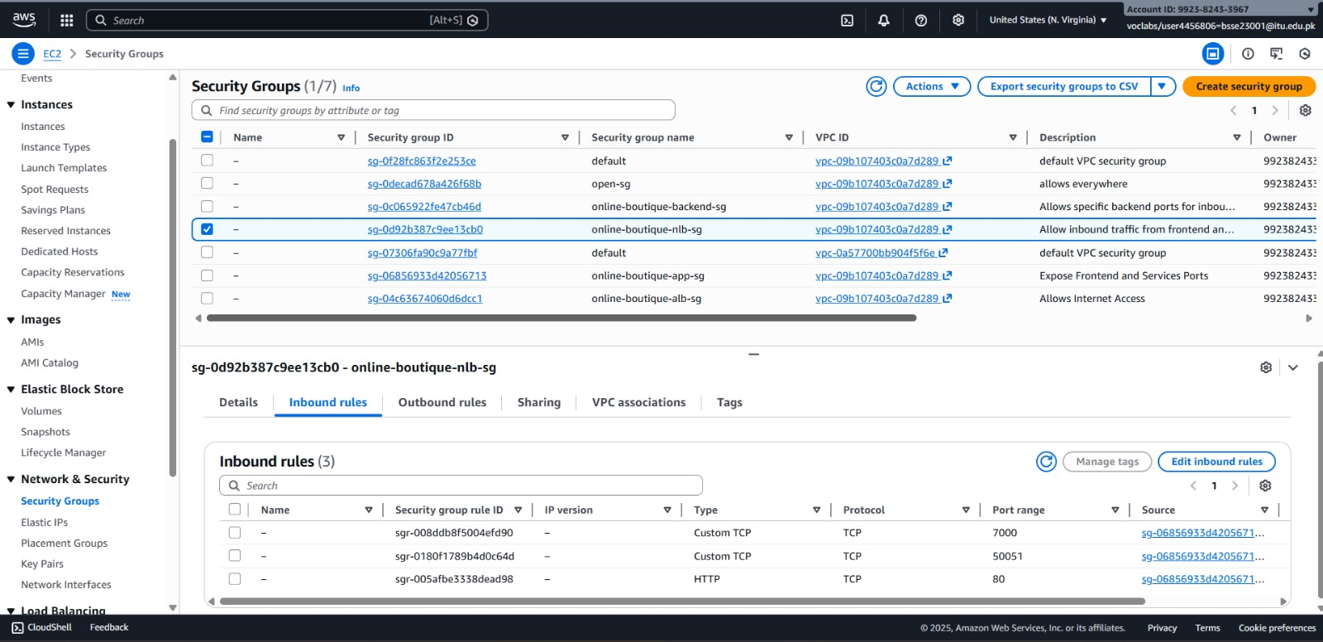
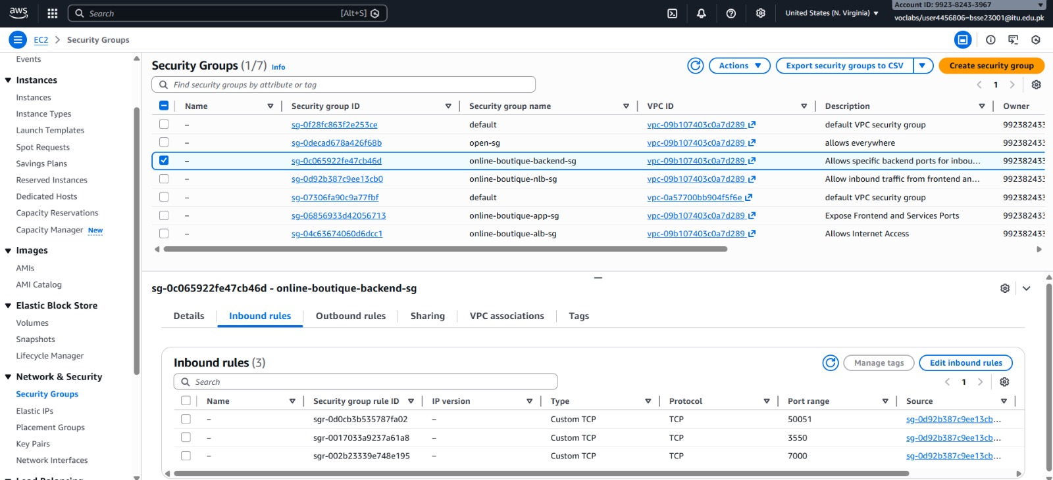
Image 2.2: Security Groups

Slide 15
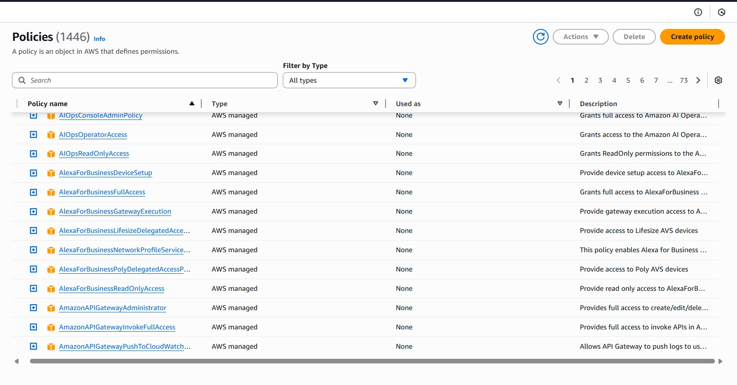
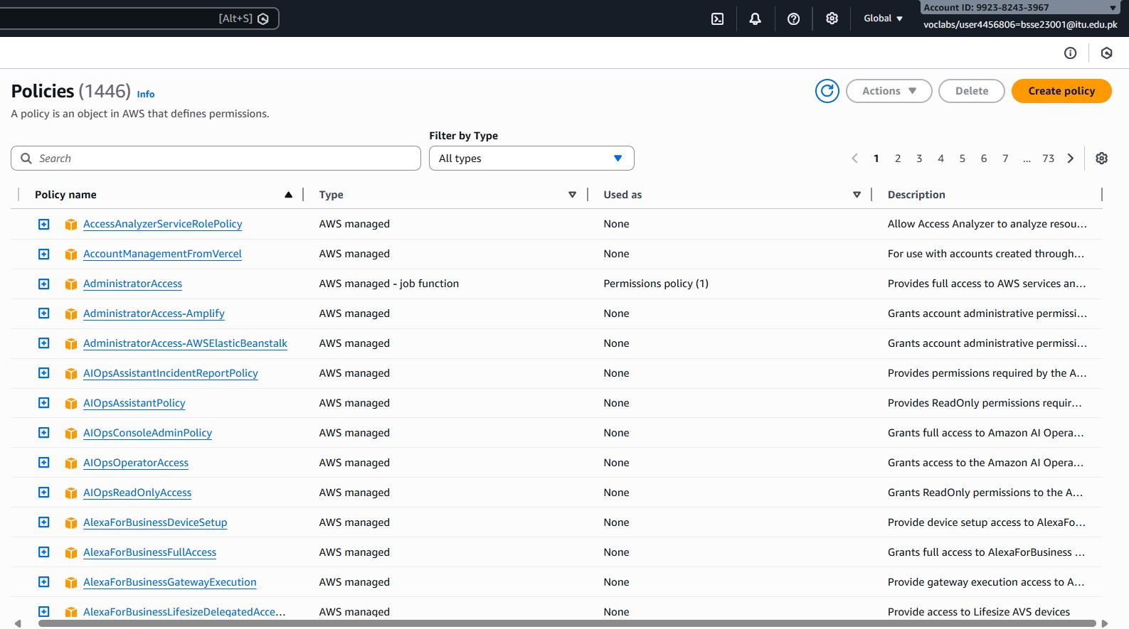
Policies

Slide 16

Database and Storage Layer
DynamoDB Tables: Created tables for CartItems (Partition Key: SessionID) and ProductCatalog (Partition Key: ProductID).
S3 Buckets: Configured app.static.com bucket with public read access disabled, accessible only via CloudFront OAI (Origin Access Identity).

Slide 17
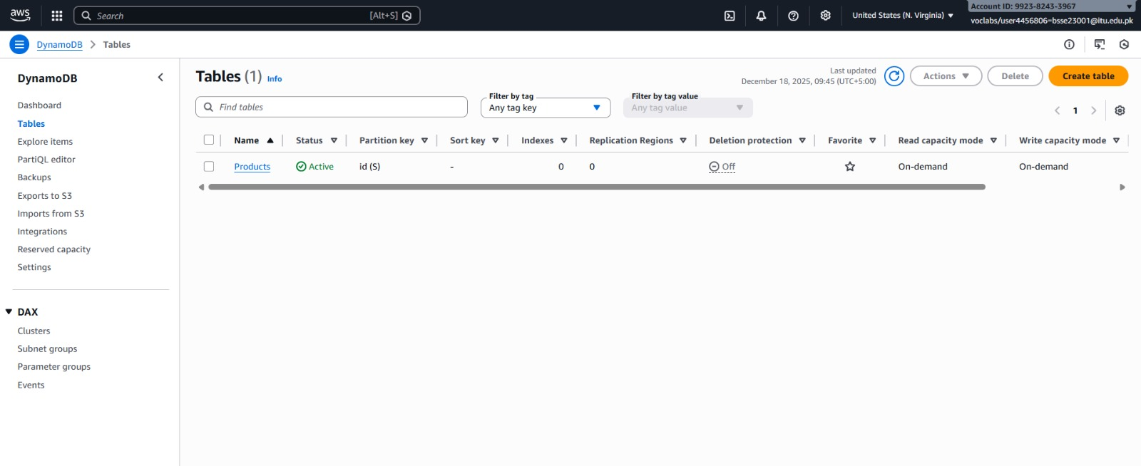
DynamoDB ScreenShot

Slide 18

Containerization and ECS Deployment
ECR Repositories: Created repositories for user-service, order-service, and product-service.
Command used: aws ecr create-repository --repository-name order-service
Task Definitions: Defined Fargate tasks allocating 0.5 vCPU and 1GB RAM per container.
Service Deployment: Deployed ECS Services with a desired count of 2 tasks for high availability.

Slide 19
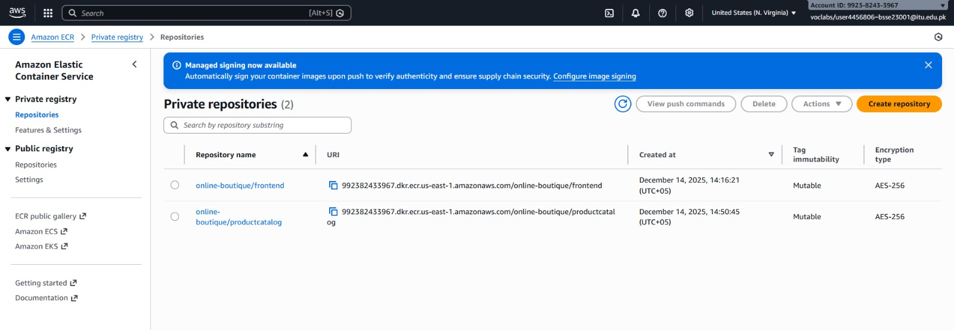
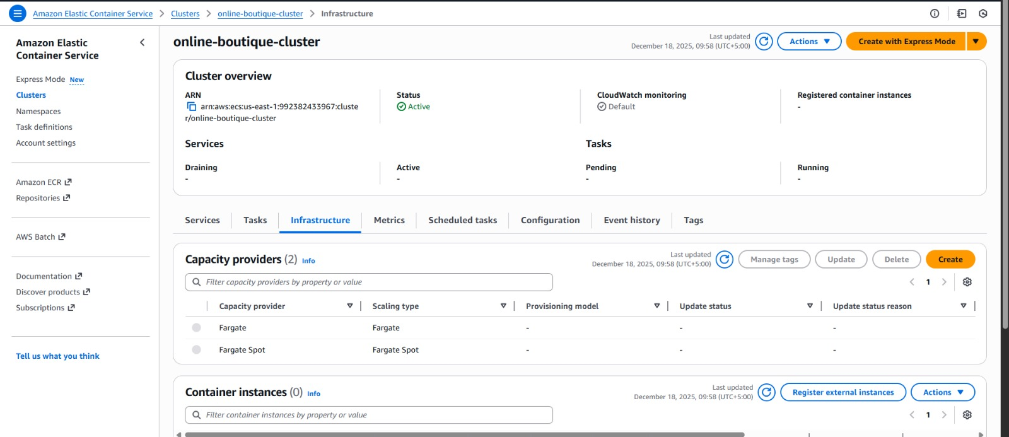

Slide 20
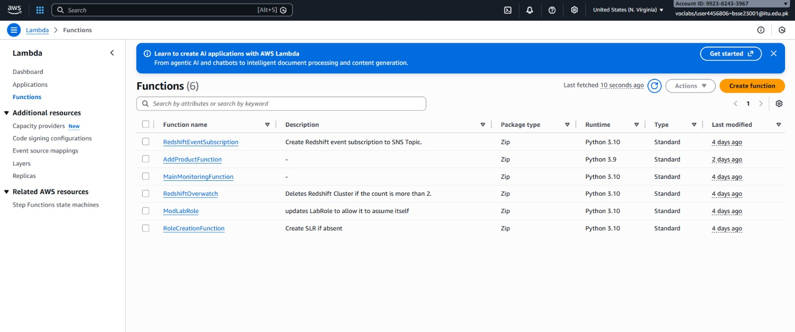
Lambda Functions

Slide 21
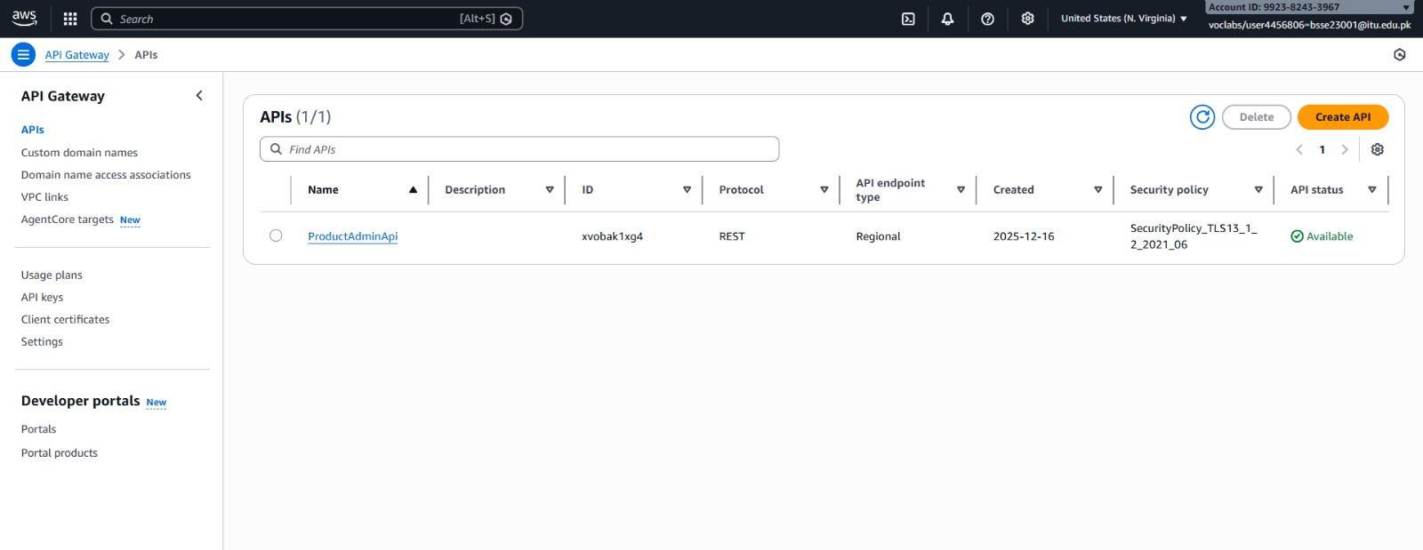
API Gateway

Slide 22
Frontend and Content Delivery
Load Balancer: Configured an Application Load Balancer (ALB) to route traffic based on path patterns (e.g., /api/orders -> Order Service Target Group).
CloudFront: Set up a distribution pointing to the S3 bucket, ensuring HTTPS enforcement.
Route 53: Mapped the domain alias records (A-records) to the CloudFront distribution and the ALB.

Slide 23

Monitoring and Maintenance
CloudWatch Alarms: Configured alarms to trigger if CPU utilization exceeds 70% in the ECS cluster.
Equation used for scaling trigger:
$$CPU_{utilization} = \frac{\sum (CPU_{used})}{\sum (CPU_{reserved})} \times 100$$
Logs: Enabled CloudWatch Logs for all Fargate containers to troubleshoot application errors.

Slide 24
Results

Slide 25
Monolithic vs. Microservices
Criteria | Monolithic Architecture | Microservices Architecture
Scalability | Entire application must scale as a unit; resource inefficient. | Individual services scale independently (e.g., ECS Fargate); optimized resource utilization.
Deployment | Single, large deployment cycle; slower release cycles and high risk. | Independent service deployments; faster time-to-market and lower risk per release.
Failure Isolation | Single point of failure; one bug can crash entire system. | Isolated failures; faulty service (e.g., Cart) does not affect others (e.g., Orders).
Technology Flexibility | Limited to single technology stack across the entire application. | Each service can use the optimal technology stack (e.g., Java for Orders, Python for Analytics).
Database Management | Centralized single database; high potential for contention and bottlenecks. | Distributed databases per service (RDS for Orders, DynamoDB for Sessions); reduced contention.
Operational Complexity | Lower initial complexity; significantly harder to troubleshoot and maintain at scale. | Higher initial setup complexity; provides better observability and targeted monitoring (CloudWatch).
Cost Efficiency | Lower initial infrastructure costs; costs escalate quickly and inefficiently at scale. | Higher initial costs; achieves 40% reduction at scale through efficient auto-scaling (ECS).

Slide 26
AWS Service Cost Estimation (Monthly)
AWS Service | Usage Metric | Estimated Monthly Cost | Annual Cost
ECS Fargate (Compute) | 2 tasks × 0.5 vCPU, 1GB RAM (24/7 Baseline) | $45.60 | $547.20
RDS MySQL (Transactional DB) | Multi-AZ, db.t3.small (24/7 HA) | $180.00 | $2,160.00
DynamoDB (NoSQL/Sessions) | 100 GB storage + estimated on-demand read/write capacity | $75.00 | $900.00
ElastiCache (Redis) (Caching) | cache.t3.micro (24/7) | $22.50 | $270.00
S3 Storage | 500 GB Standard Storage + data transfer | $35.00 | $420.00
CloudFront (CDN) | 10 TB data transfer out (Global Content Delivery) | $85.00 | $1,020.00
Application Load Balancer | 1 ALB + estimated Load Balancer Capacity Units (LCUs) | $22.50 | $270.00
Route 53 (DNS) | 1 hosted zone + 1M queries | $12.50 | $150.00
CloudWatch | Logs + alarms (estimated) | $25.00 | $300.00
Total Estimated Monthly Cost |  | $503.10 | $6,037.20

Slide 27
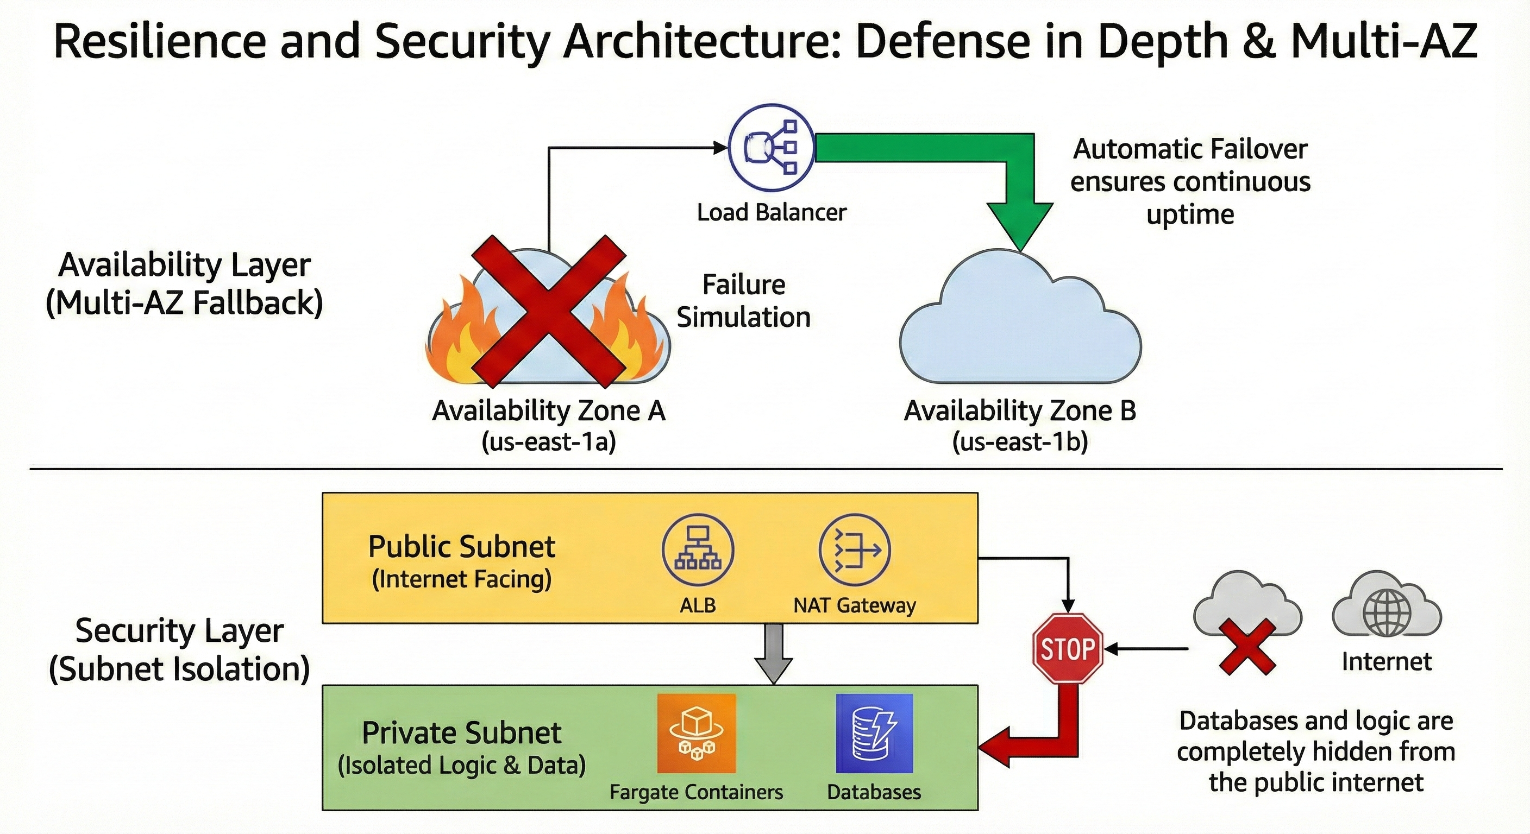

Slide 28
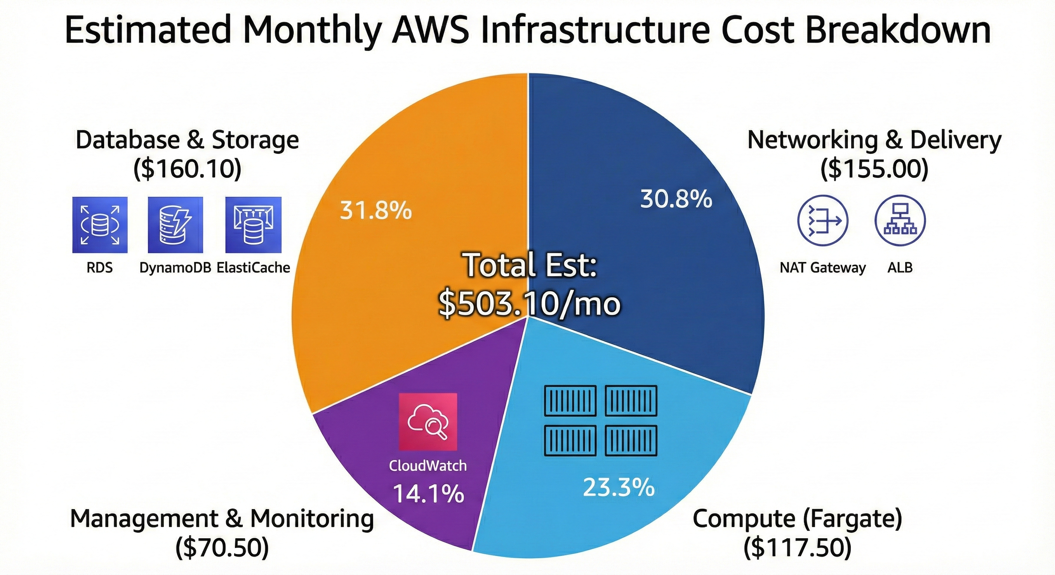

Slide 29
